Slide 1
Front-End Web Development Using React (CSS3)
Front-End Web Development Using React – CSS3
Eng. Reem Hassan Ahmed

Slide 2
Table of contents
01
04
02
05
03
06
Animations
Pseudo elements
07
Flex-Box
Pagination and variables
08
Transitions
Grid
Transform
Background image and size
09
Responsive

Slide 3
01
Animation
Front-End Web Development Using React – CSS3

Slide 4
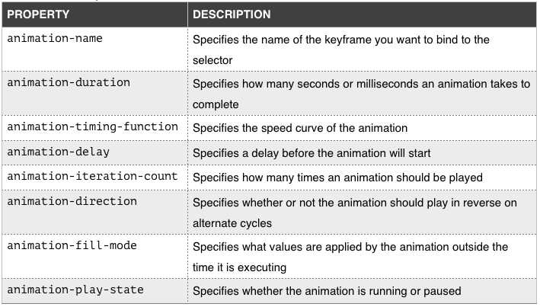
Animation property
An animation lets an element gradually change from one style to another.
Animation is used using @keyframes keyword.
Keyframes hold what styles the element will have at certain times.

Slide 5
Animation property
Direction:
normal - The animation is played as normal (forwards). This is default
reverse - The animation is played in reverse direction (backwards)
alternate - The animation is played forwards first, then backwards
alternate-reverse - The animation is played backwards first, then forwards

Slide 6
Animation property
Timing-function:
ease - Specifies an animation with a slow start, then fast, then end slowly (this is default)
linear - Specifies an animation with the same speed from start to end
ease-in - Specifies an animation with a slow start
ease-out - Specifies an animation with a slow end
ease-in-out - Specifies an animation with a slow start and end

Slide 7
Animation property
fill-mode:
none - Default value. Animation will not apply any styles to the element before or after it is executing
forwards - The element will retain the style values that is set by the last keyframe (depends on animation-direction and animation-iteration-count)
backwards - The element will get the style values that is set by the first keyframe (depends on animation-direction), and retain this during the animation-delay period
both - The animation will follow the rules for both forwards and backwards, extending the animation properties in both directions

Slide 8
02
Transition
Front-End Web Development Using React – CSS3

Slide 9
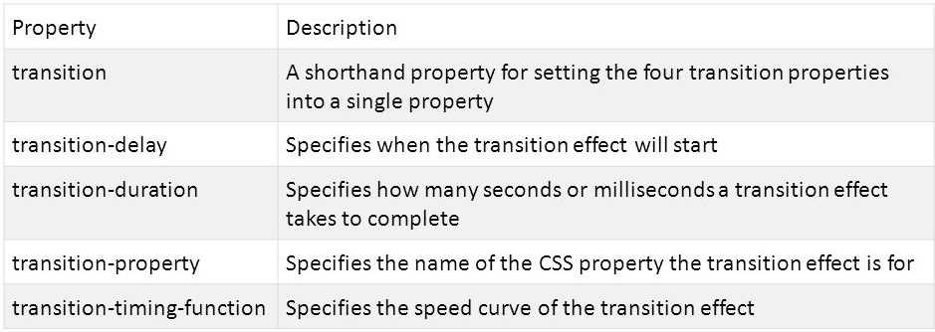
Transition
Transitions allows you to change property values, over a given duration.
Transition can be used on css hover, focus, and active state.

Slide 10
Transition
Timing-function:
ease - Specifies an transition with a slow start, then fast, then end slowly (this is default)
linear - Specifies an transition with the same speed from start to end
ease-in - Specifies an transition with a slow start
ease-out - Specifies an transition with a slow end
ease-in-out - Specifies an transition with a slow start and end

Slide 11
03
Transform
Front-End Web Development Using React – CSS3

Slide 12
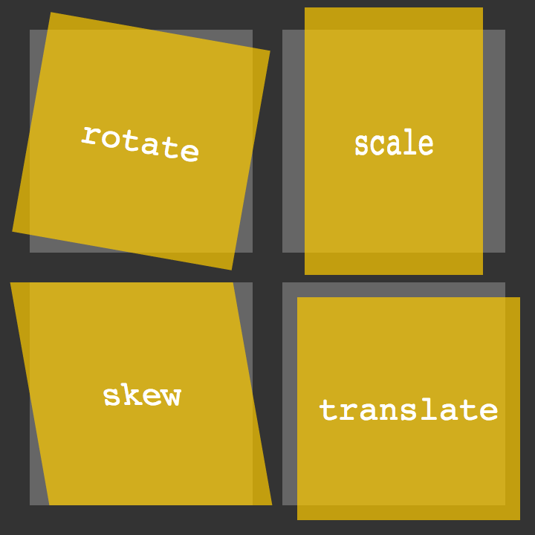
Transform property
Transforms allow you to manipulate the position, rotation, and scale of an element.
This can be used for creating animations and visual effects.
In real world, transform means to change shape or appearance of an element.

Slide 13
Transform property
Transform methods:
translate(): Moves an element from its current position (according to the parameters given for the X-axis and the Y-axis).
rotate(): Rotates an element clockwise or counter-clockwise according to a given degree.
scaleX(): Increases or decreases the width of an element.
scaleY(): Increases or decreases the height of an element.
scale(): Increases or decreases the size of an element.
skewX(): Skews an element along the X-axis by the given angle.
skewY(): Skews an element along the Y-axis by the given angle.
skew(): Skews an element along the X and Y-axis by the given angles.
matrix(): combines all the 2D transform methods into one.

Slide 14
04
Pseudo elements
Front-End Web Development Using React – CSS3

Slide 15
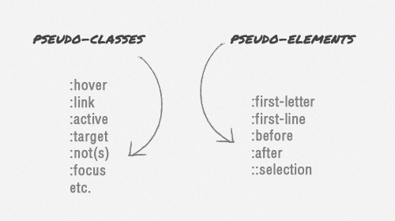
Pseudo elements
A CSS pseudo-element is used to style specified parts of an element.
::first-line pseudo-element is used to add a special style to the first line of a text.(can only be applied to block-level elements.)
::first-letter pseudo-element is used to add a special style to the first letter of a text. (can only be applied to block-level elements.)
::before pseudo-element can be used to insert some content before the content of an element.
::after pseudo-element can be used to insert some content after the content of an element.

Slide 16
05
Pagination and variables
Front-End Web Development Using React – HTML

Slide 17
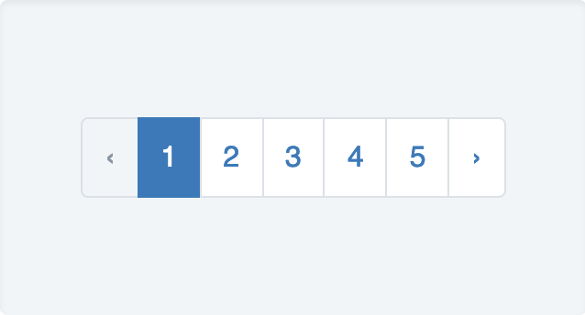
Pagination
Pagination is a method by which a document is separated into pages using page numbers

Slide 18
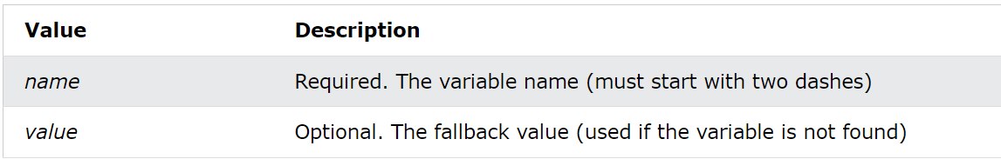
Variables
The var() function is used to insert the value of a CSS variable.
Syntax: var(--name, value)
The variable name must begin with two dashes (--) and it is case sensitive!

Slide 19
06
Background and image size
Front-End Web Development Using React – HTML

Slide 20
Background and image sizing
background-size: cover; is used to resize the background image to cover the entire container
object-fit: cover; the image keeps its aspect ratio and fills the given dimension. The image will be clipped to fit.
object-fit: contain; the image keeps its aspect ratio, but is resized to fit within the given dimension.
object-fit: fill; the image is resized to fill the given dimension. If necessary, the image will be stretched or squished to fit.

Slide 21
07
Flex-box
Front-End Web Development Using React – HTML

Slide 22
Flex-box
Flex-box is a one-dimensional layout method for arranging items in rows or columns. Items flex (expand) to fill additional space or shrink to fit into smaller spaces. This article explains all the fundamentals.
Container properties:
The flex-direction property defines in which direction the container wants to stack the flex items.
The flex-wrap property specifies whether the flex items should wrap or not.
The flex-flow property is a shorthand property for setting both the flex-direction and flex-wrap properties.
The justify-content property is used to align the flex items:
The align-items property is used to align the flex items.
The align-content property is used to align the flex lines.

Slide 23
Flex-box
Flex-box is a one-dimensional layout method for arranging items in rows or columns. Items flex (expand) to fill additional space or shrink to fit into smaller spaces. This article explains all the fundamentals.
Child properties:
The order property specifies the order of the flex items.
The flex-grow property specifies how much a flex item will grow relative to the rest of the flex items.
The flex-shrink property specifies how much a flex item will shrink relative to the rest of the flex items.
The flex-basis property specifies the initial length of a flex item.
The flex property is a shorthand property for the flex-grow, flex-shrink, and flex-basis properties.
The align-self property specifies the alignment for the selected item inside the flexible container.

Slide 24
08
Grid
Front-End Web Development Using React – HTML

Slide 25
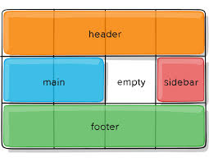
Grid layout
The CSS Grid Layout Module offers a grid-based layout system, with rows and columns, making it easier to design web pages without having to use floats and positioning.
An HTML element becomes a grid container when its display property is set to grid or inline-grid.
The column-gap property sets the gap between the columns:
The row-gap property sets the gap between the rows:
The gap property is a shorthand property for the row-gap and the column-gap properties:

Slide 26
Grid layout Cont.
Container properties:
The grid-template-columns property defines the number of columns in your grid layout, and it can define the width of each column.
The grid-template-columns property can also be used to specify the size (width) of the columns.
The grid-template-rows property defines the height of each row.
The justify-content property is used to align the whole grid inside the container.
The align-content property is used to vertically align the whole grid inside the container.

Slide 27
Grid layout Cont.
Items properties:
The grid-column property defines on which column(s) to place an item.
The grid-column property is a shorthand property for the grid-column-start and the grid-column-end properties.
The grid-row property defines on which row to place an item.
The grid-row property is a shorthand property for the grid-row-start and the grid-row-end properties.
The grid-area property can be used as a shorthand property for the grid-row-start, grid-column-start, grid-row-end and the grid-column-end properties.
The grid-area property can also be used to assign names to grid items.

Slide 28
09
Responsive design
Front-End Web Development Using React – HTML

Slide 29
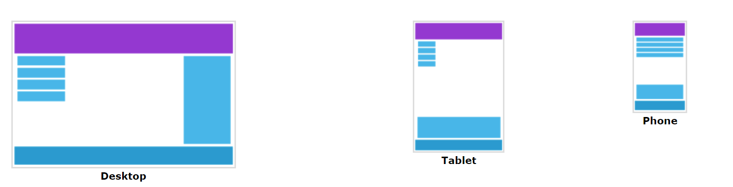
Responsive introduction
Responsive web design makes your web page look good on all devices using only HTML and CSS.

Slide 30
Viewport
The viewport is the user's visible area of a web page.
The viewport varies with the device, and will be smaller on a mobile phone than on a computer screen.
The width=device-width part sets the width of the page to follow the screen-width of the device (which will vary depending on the device).
The initial-scale=1.0 part sets the initial zoom level when the page is first loaded by the browser.

Slide 31
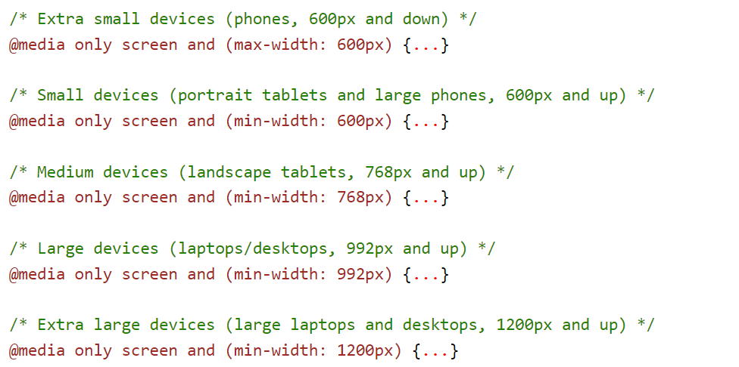
Media query
We use the @media rule to include a block of CSS properties only if a certain condition is true.
Screen sizes:

Slide 32
Thanks!
Front-End Web Development Using React – CSS3
Does anyone have any question?
ReemHassan160299@gmail.com
+201092427577
Please keep this slide for attribution

